Slide 1




UB Informs: RAG WORKSHOP
Presenters:
Shruti Kumari
V L Sivasai Mani Harshith

Slide 2
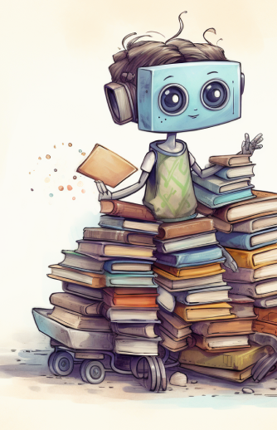
Retrieval Augmented Generation
z

Slide 3
Large Language Models Eg: GPT-4o-mini, Llama, Mistral etc
A type of AI program that can recognize and generate text, among other tasks.
They are very large models that are pretrained on vast amount of data.
Built on transformer architecture, is a set of neural network that consists of an encoder and decoder with self attention capabilities.
It can perform completely different tasks such as answering questions, summarizing documents, translating languages and completing sentences.

Slide 4
LLMs
A computer program that has been fed enough examples to be able to recognize and interpret human language or other types of complex data.
Example

Slide 5
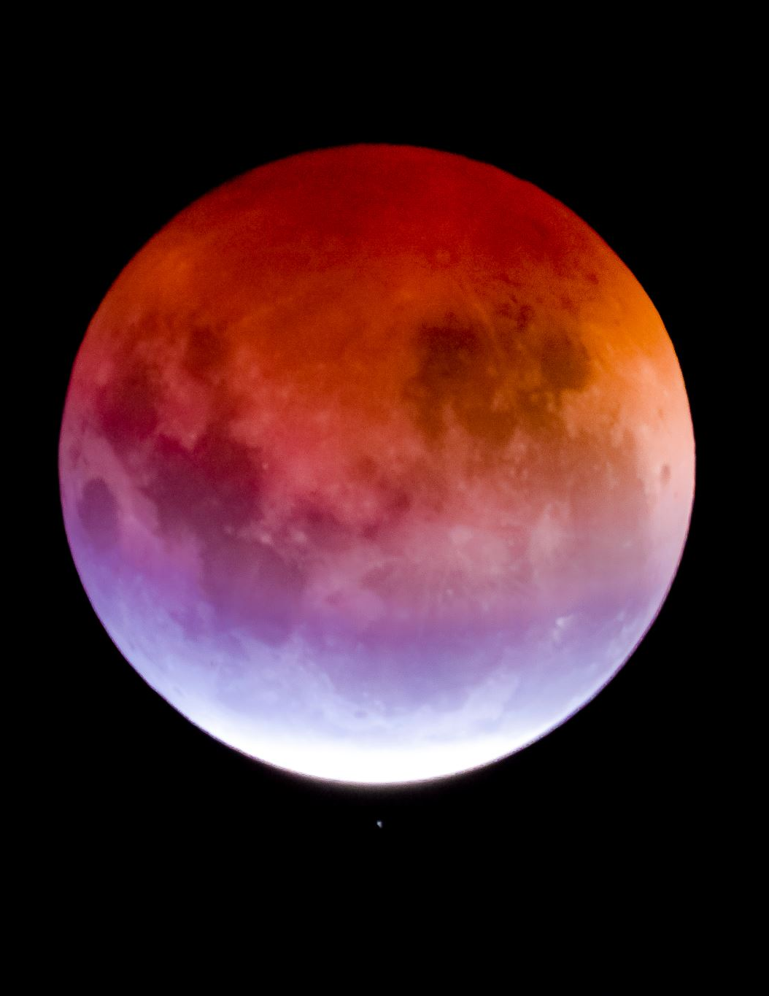
Example
Which planet has the greatest number of moons?
Planet?, Moons?
Ans: Jupiter, 88
Concerns: No source, Out of date
These are challenges

Slide 6

Example
Look up on NASA’s website.
Saturn, 146 moons
Grounded the answer, not “hallucinated”.

Slide 7
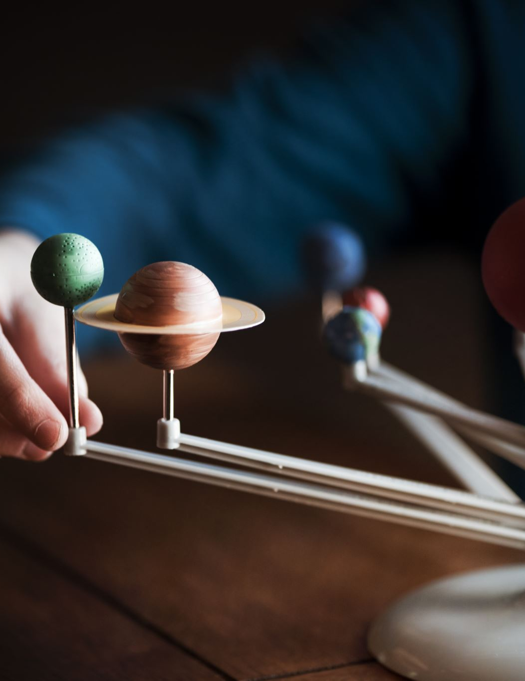
GENERATION
User asks about moons
LLM would generate an answer from it’s parameters during training. (Jupiter, 88)
What happened when you add Retrieval Augmented part?

Slide 8
Retrieval Augmentation
Instead of just relying on what LLM knows
Add a context store (Open: Internet, Closed: Docs)
LLM first talks to this context store
Retrieve the most relevant information for the query
With this retriever augmented info, generate the response
Final ans: Saturn, 146!

Slide 9
Retrieval Augmentation Generation (RAG)
Prompt
If LLM, generate a response
If RAG framework:
Generative model: Go and retrieve relevant context
Combine that with user’s question
Only then generate a response
Now, there is an evidence to back the response

Slide 10
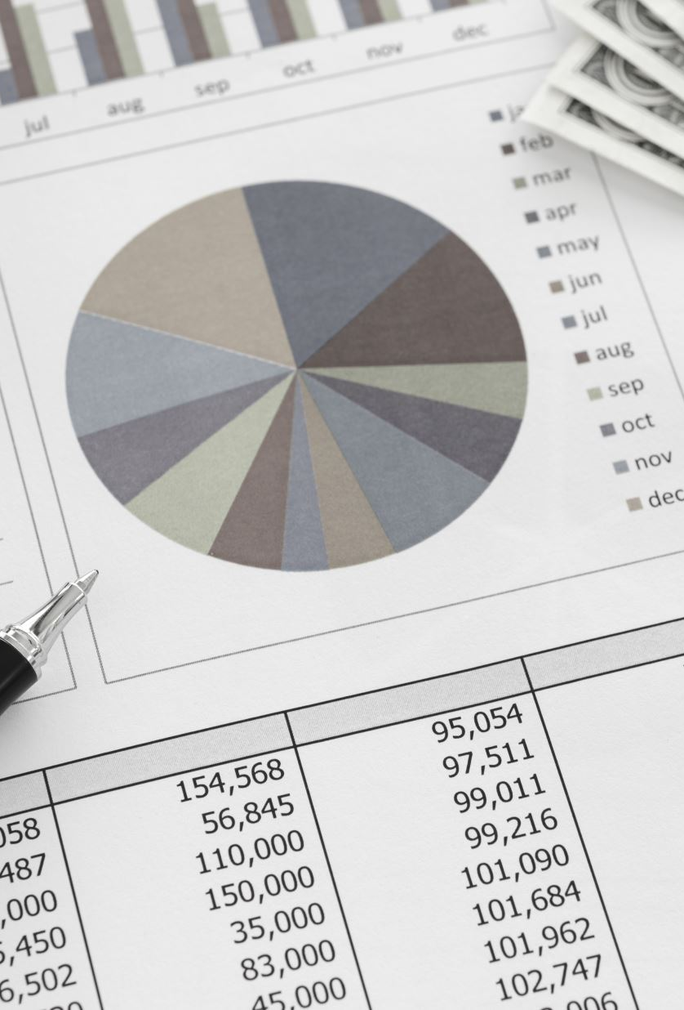
How RAG solves LLM challenges?
As new data is found
Just augment it to the context store
Information update concern solved
LLM is now being instructed to pay attention to primary source data before responding
Less chance of hallucination, data leak

Slide 11


Query = A complex mystery!
Retriever component, as a detective
Scours databases, knowledge sources for relevant information and evidence.
It compiles a comprehensive set of facts and data points
Generator component, as a storyteller
Takes the information
Transforms into a coherent and engaging narrative
Presenting a clear and detailed account of the mystery like a detective novel author

Slide 12

RAG
RAG = A framework that allows GenAI models to access external information not included in its training data or model parameters.
Best of both retrieval and generative methods

Slide 13
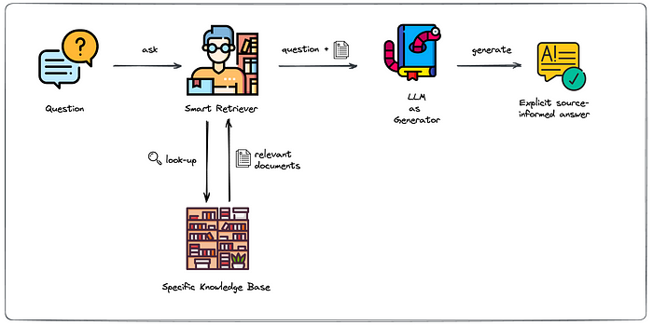
Overview
z

Slide 14
RAG Components
External Data (Outside LLM)
Vector Embeddings
VectorDB to store Vector Embeddings
Retriever
Ranker
Augmentation of the LLM prompt
Generator (LLM)

Slide 15

Querying PDFs Using multimodal RAG

Slide 16
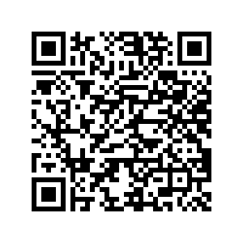
Code
https://colab.research.google.com/drive/1zl-MhvfBUl2OAdNMtvExLqVgFf1Db8sM?usp=sharing

Slide 17
What will we see today?
Query a pdf
Consider the images/tables/plots any other visualizations that are in the document
Use all of this as context for the language model
To form the final answer

Slide 18
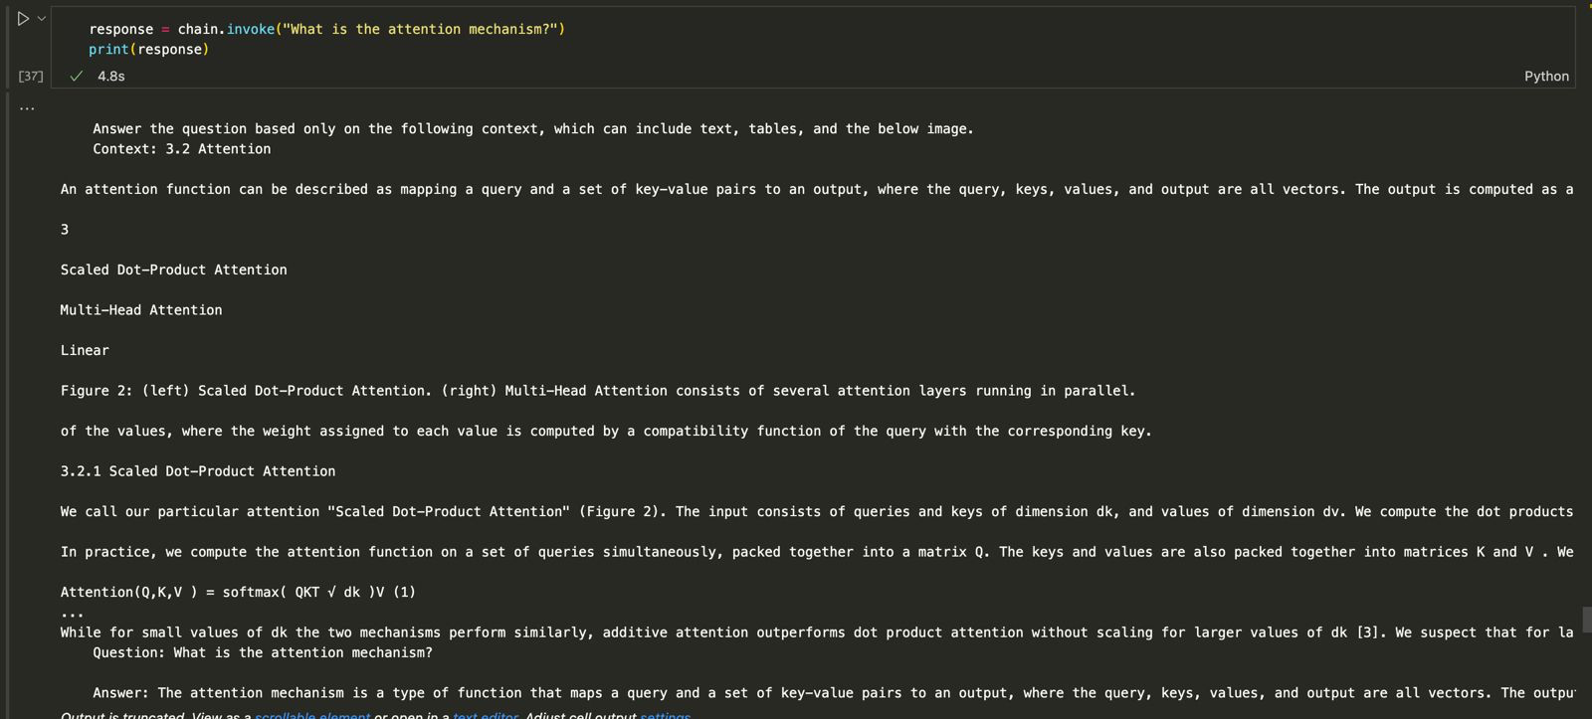
Expectation
z
Notes:
Try without chunking to show len of chunks and different categories, then show with chunking

Slide 19





It all starts with a simple PDF!
UNSTRUCTURED
PDF
TEXT
TABLES
IMAGES

Slide 20


Summary
Summary
Summary
Doc id
Summary
Doc id
Summary
Doc id
Summary
Doc store
Text Embeddings
Vector DB

Slide 21


Doc store
Vector DB
Doc id
Summary
QUERY
Summary
Doc id
Summary
Doc id
Doc id
Generating Response
Retrieved Documents

Slide 22

Let’s code!
z

Slide 23
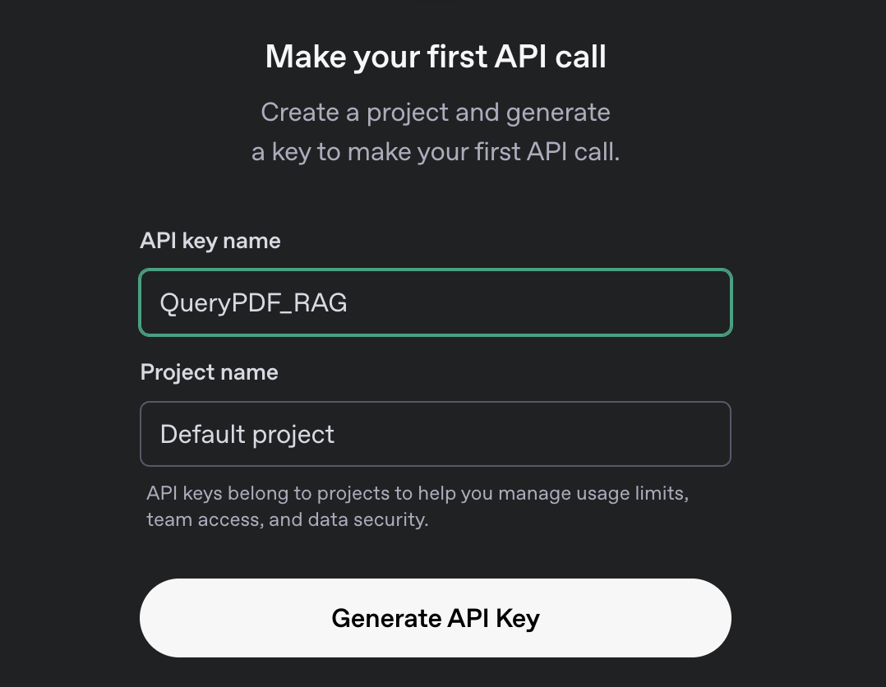
1. OPENAI_API_KEY
https://platform.openai.com/api-keys
Sign in

Slide 24
2. GROQ_API_KEY
https://console.groq.com/keys
Sign in

Slide 25
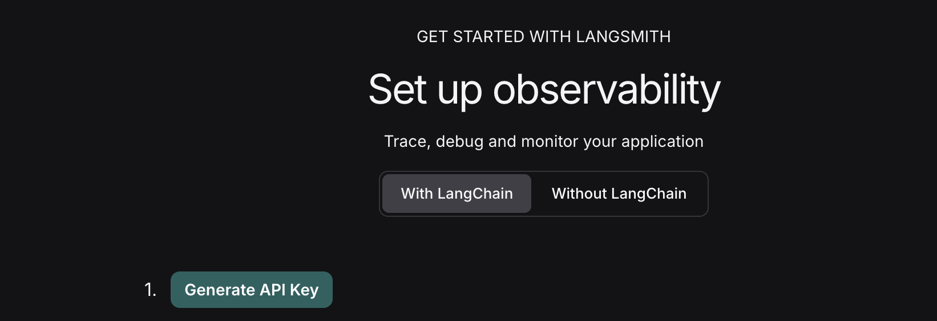
3. LANGCHAIN_API_KEY
https://www.langchain.com/Sign in --> Get Started

Slide 26
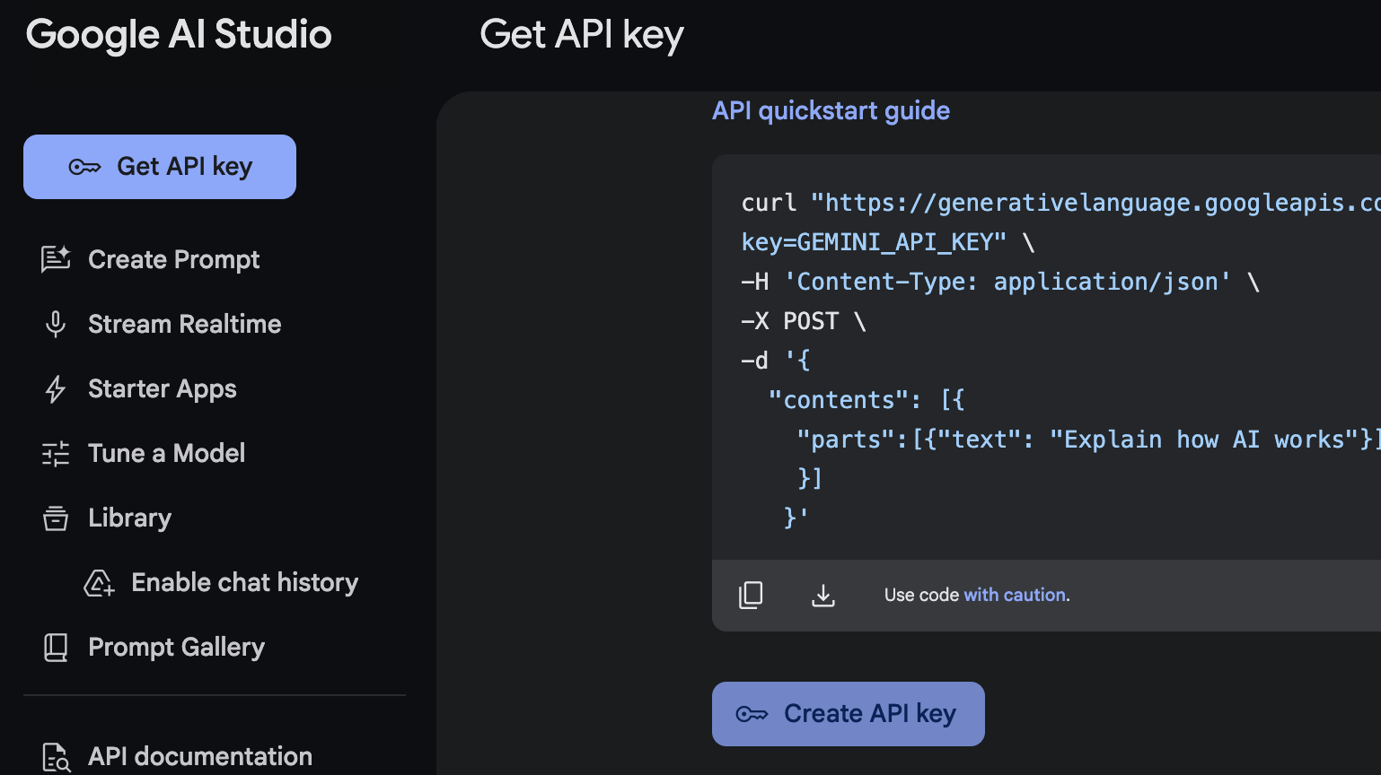
4. GOOGLEAI_API_KEY
https://aistudio.google.com/apikey
Sign in --> Get API Key

Slide 27
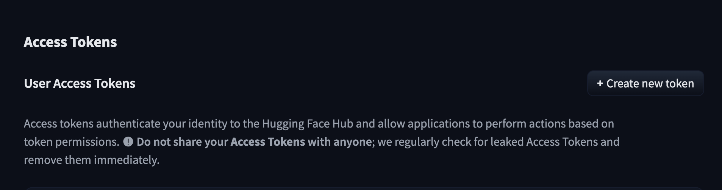
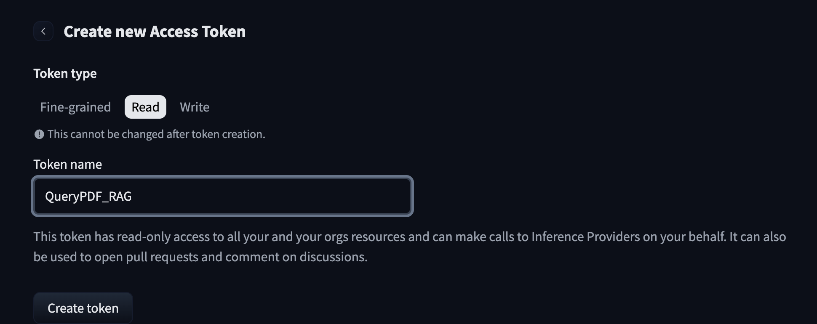
5. HF_API_KEY
https://huggingface.co/settings/tokens
Sign in

Slide 28
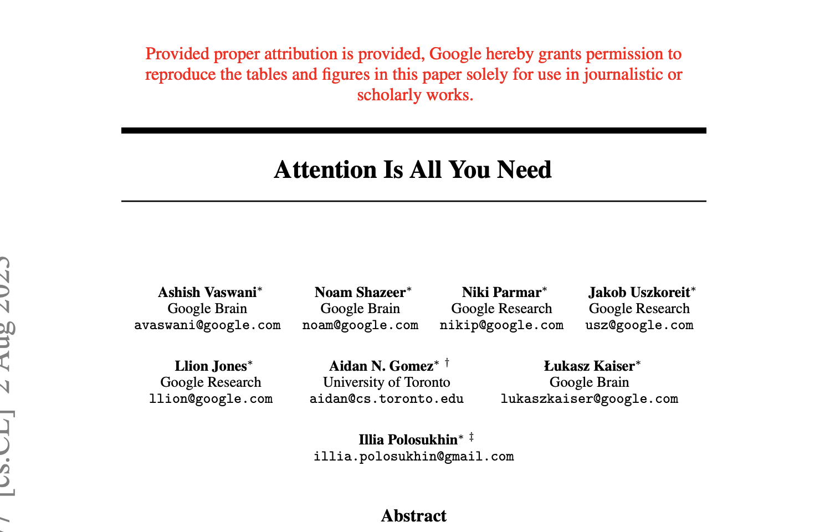
PDF
https://arxiv.org/pdf/1706.03762
Rename to attention.pdf

Slide 29

MORE RESOURCES
https://github.com/langchain-ai/langchain/blob/master/cookbook/Semi_structured_and_multi_modal_RAG.ipynb?ref=blog.langchain.dev
https://medium.com/@bpmcgough/building-an-accurate-tested-rag-pipeline-for-pdf-document-search-with-langchain-01032abbe5e1
https://buffalo.box.com/s/3fe8k2ciblo5ov351gm98rcxjjx7e17e

